Slide 1

Azure IoT Hub - Workshop
Event driven push model for your devices in the real-time processing
Roman Kiss
Microsoft Integration MVP (2003 – 2013)
February 2017

Slide 2
Azure IoT Hub - Workshop
Agenda:
Introduction and goals
Session 1 - Azure IoT Hub
Session 2 - IoT Devices
Session 3 - End-To-End Streaming and Eventing
Summary & What The Next

Slide 3
Azure IoT Hub - Workshop
Introduction and goals:
Azure IoT Infrastructure
Setting Up Your Dev Environment
Azure Pass
Azure IoT Hub
Azure Stream Analytics
Power BI
Device Explorer Twin
Azure IoT Hub Tester
Service Bus Tester (Service Bus Explorer)
Visual Studio 2015/Update3 + Azure Tools + UWP
Setting Up Your Raspberry Pi3
Windows IoT Core
Copy image to microSD
Device PowerShell & Portal
Connectivity
Virtual Display
Running IoTCoreDefaultApp/BlinkyApp

Slide 4
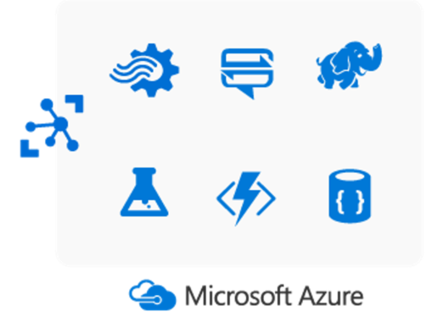
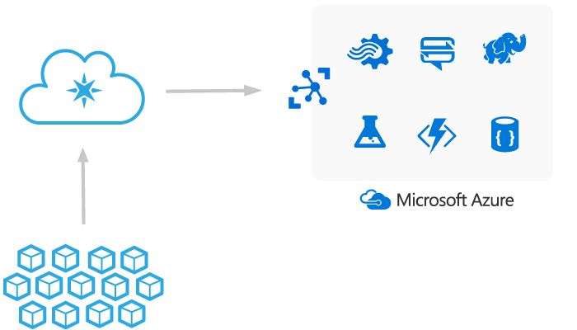


Internet of Things with Microsoft Azure
IoT Hub
Things
Devices, Apps, etc.

Slide 5
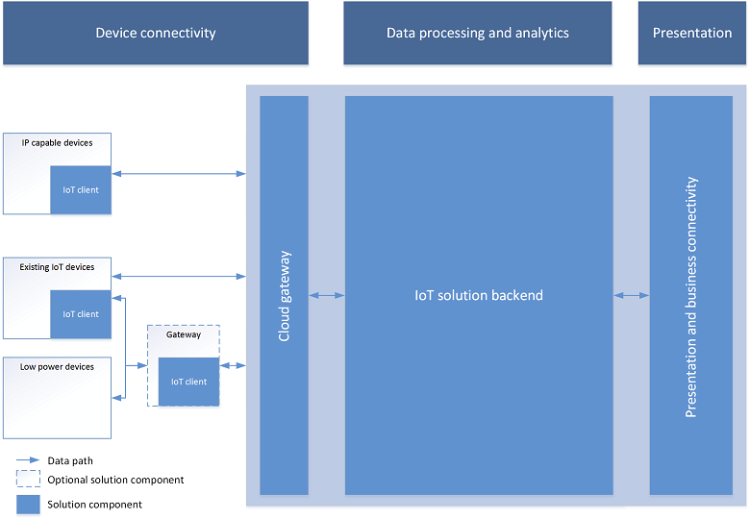
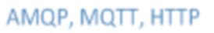

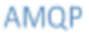
This
Workshop
Exploring End-To-End Telemetry and Non-Telemetry Data
Windows 10 IoT Core
Azure IoT Combo + Azure Functions + PowerBI

Slide 6
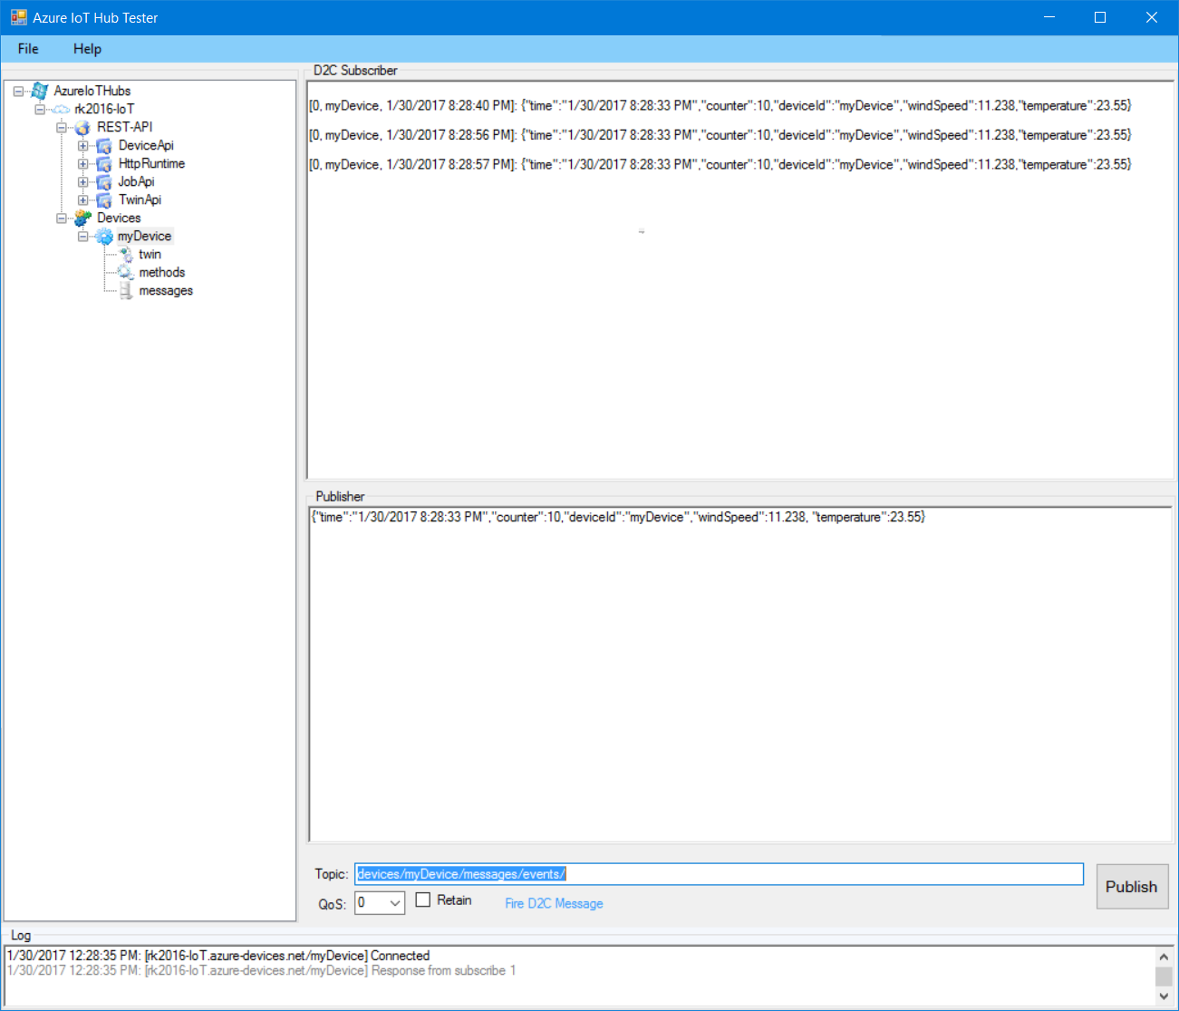
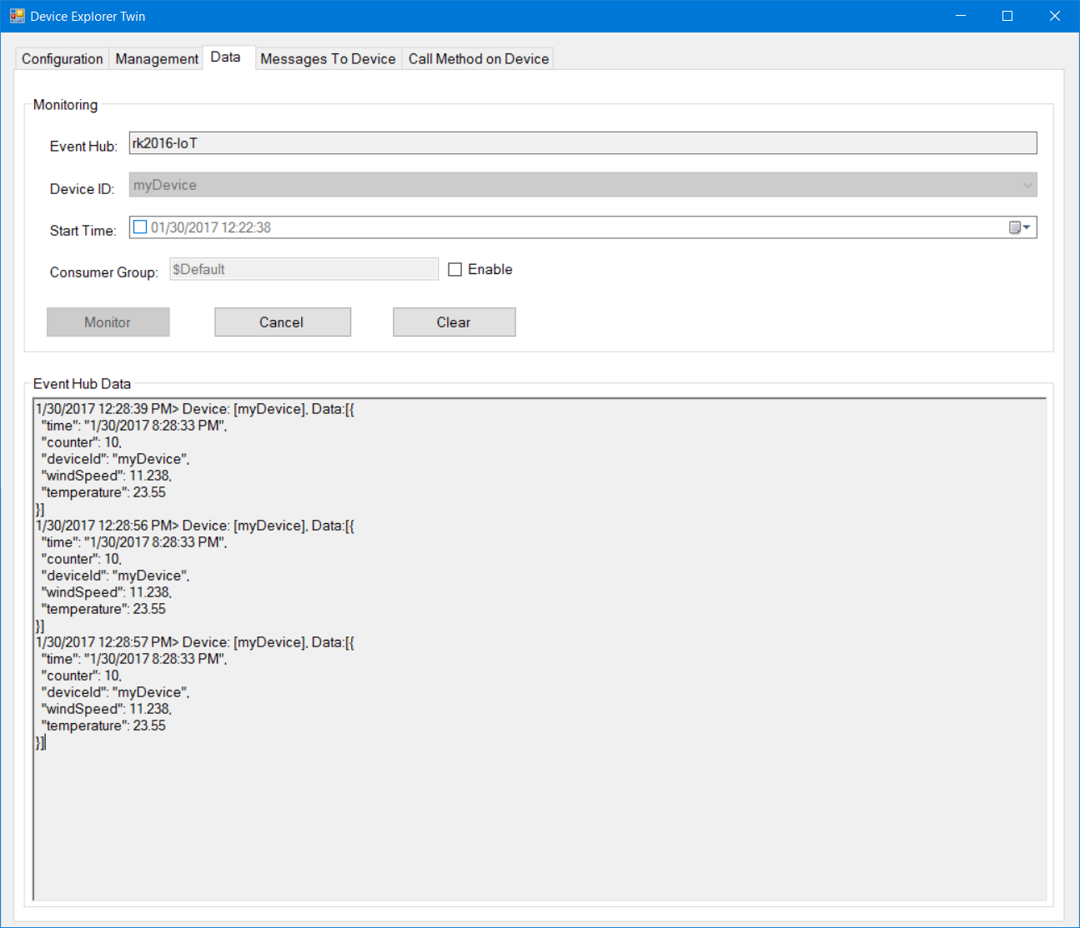

Exploring Azure IoT Hub – The Entry point of the IoT Infrastructure
Cloud Gateway
Device Simulation/Virtualization
Service Data Exploring
Azure IoT Hub Tester
(MQTT Virtual Device)
Device Explorer Twin (Service-facing side)
Azure IoT Hub

Slide 7
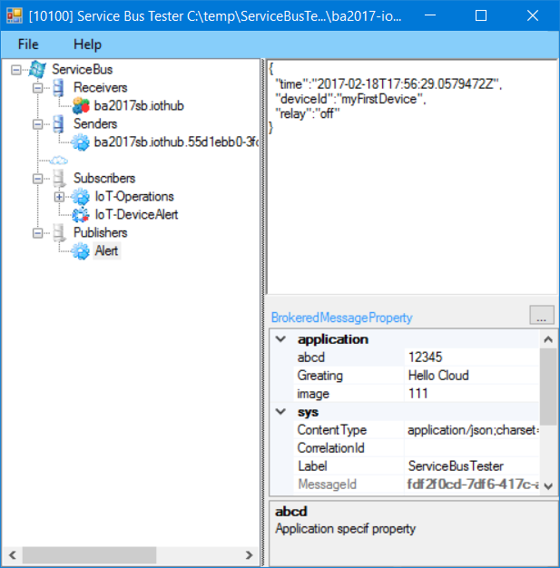
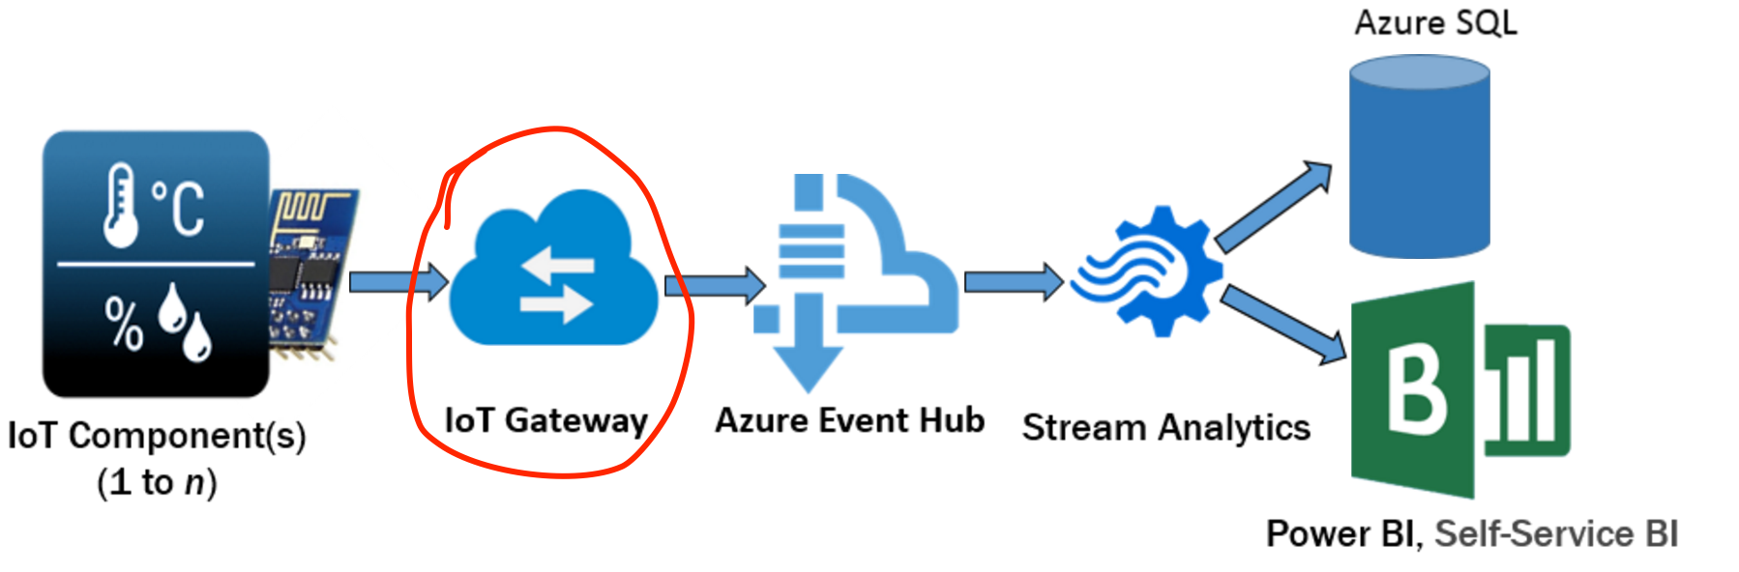
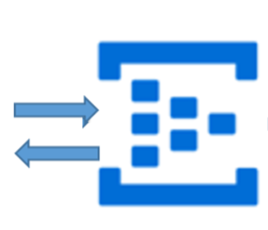
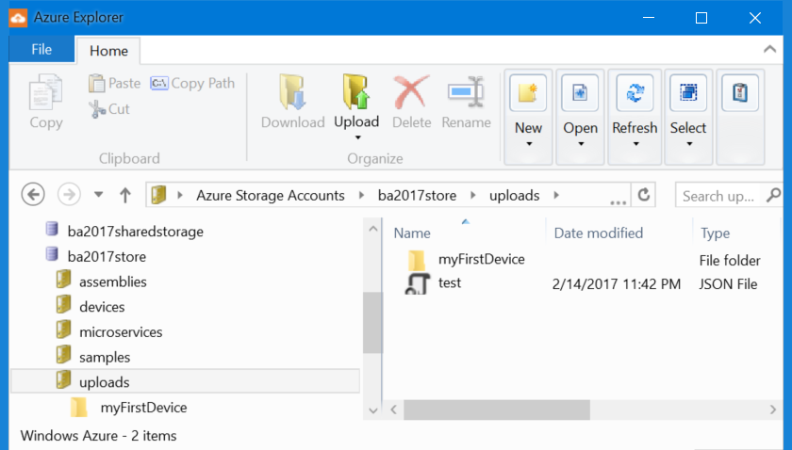
Exploring Azure IoT Combo
Virtual MQTT Device
Service Bus Tester
Azure IoT Hub Tester
(MQTT Virtual Device)
Azure IoT Combo
…
Azure IoT Hub
Azure Storage Explorer

Slide 8
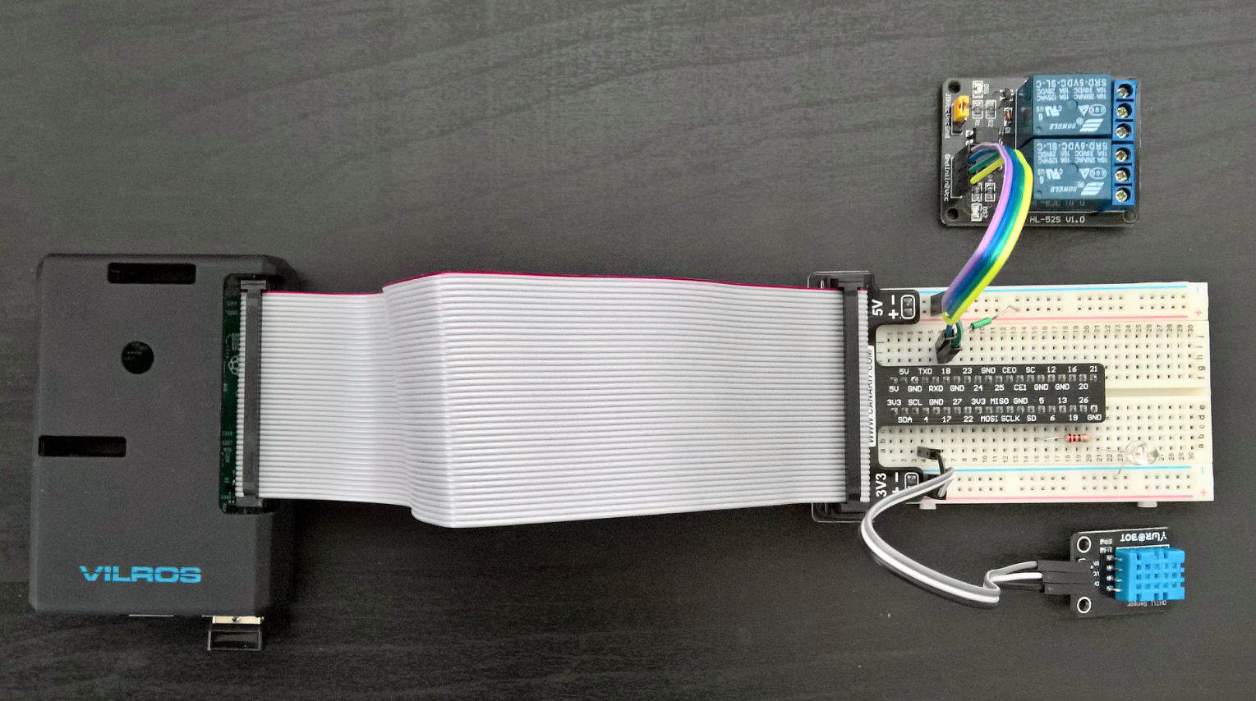
Exploring Azure IoT Combo
Real Device - Raspberry RPi3 & Windows IoT Core
Azure Blob Storage
Azure IoT Combo
Field Gateway + Sensors
Raspberry Pi3 + Windows IoT Core
Azure IoT Hub

Slide 9


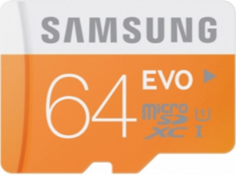
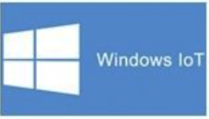

Slide 10
Setting Up Your Dev Environment
Visual Studio 2015
Azure Accounts

Slide 11
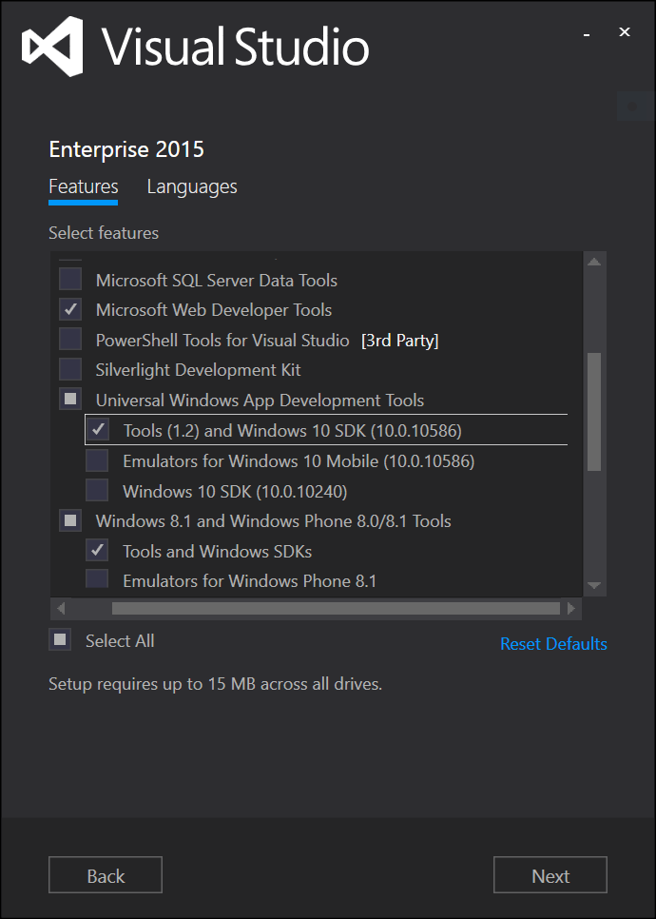
Universal Windows App Development Tools -> Tools and Windows SDK.
Windows IoT Core Project Templates https://marketplace.visualstudio.com/items?itemName=MicrosoftIoT.WindowsIoTCoreProjectTemplates
3. Enable Developer Mode on your Windows 10 Development Device
Windows Update settings -> For developers -> select Developer mode
Download Azure .Net SDK 2.9.6 https://www.visualstudio.com/vs/azure-tools/
For test purposes download and unzip:
https://github.com/ms-iot/samples
Load and compile this sample into VS2015 : HelloBlinkyBackground
https://developer.microsoft.com/en-us/windows/iot/samples/helloblinkybackground
5. IE 11 & Chrome
6. Download 3rd party tools & utilities:
Windows IoT Remote Client from Windows Apps Store
Advanced REST Client from Chrome Apps Store
MQTTBox http://www.stardock.me/mqttbox.html
Enclipse paho client https://eclipse.org/paho/clients/js/utility/

Slide 12
Have a look at the following links:
Writing UWP apps
https://developer.microsoft.com/en-us/windows/iot/docs/buildingappsforiotcore
‘Hello, blinky!’
https://developer.microsoft.com/en-us/windows/iot/Samples/helloblinky
‘Hello World!’
https://developer.microsoft.com/en-us/windows/iot/samples/helloworld
Headless (Background) service
https://developer.microsoft.com/en-us/windows/iot/samples/helloblinkybackground
Build an IoT solution by using Stream Analytics
https://docs.microsoft.com/en-us/azure/stream-analytics/stream-analytics-build-an-iot-solution-using-stream-analytics

Slide 13
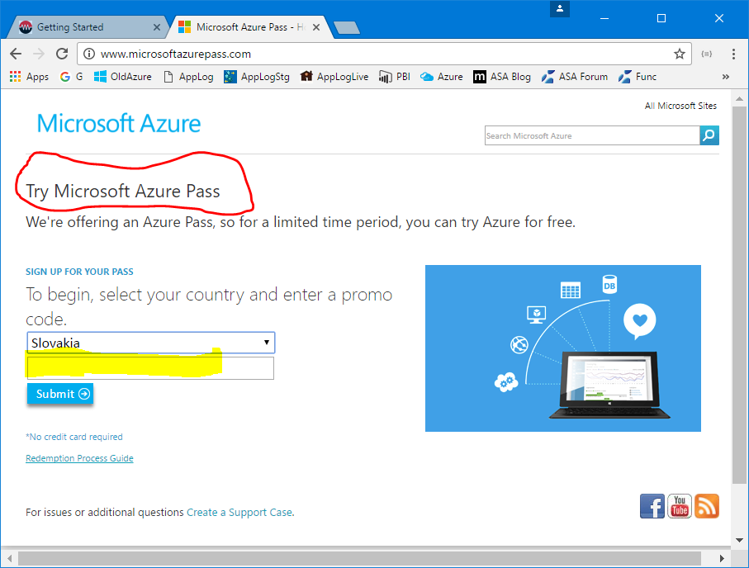
Azure Pass

Slide 14
Wow!
We have an access to the Microsoft Azure
Let’s create the following accounts:
Storage (xy2017store c:{assemblies, devices, microservices, samples, uploads} )
Service Bus (xy2017sb q:{iothub, myqueue} t:{operation, alert} )
IoT Hub (xy2017iot fileupload, endpoints)
Stream Job (xy2017sjob inputs, outputs)
Azure Function (xy2017fnc EH_IoTHubOperations, SBQ_IoTHubBridge)

Slide 15
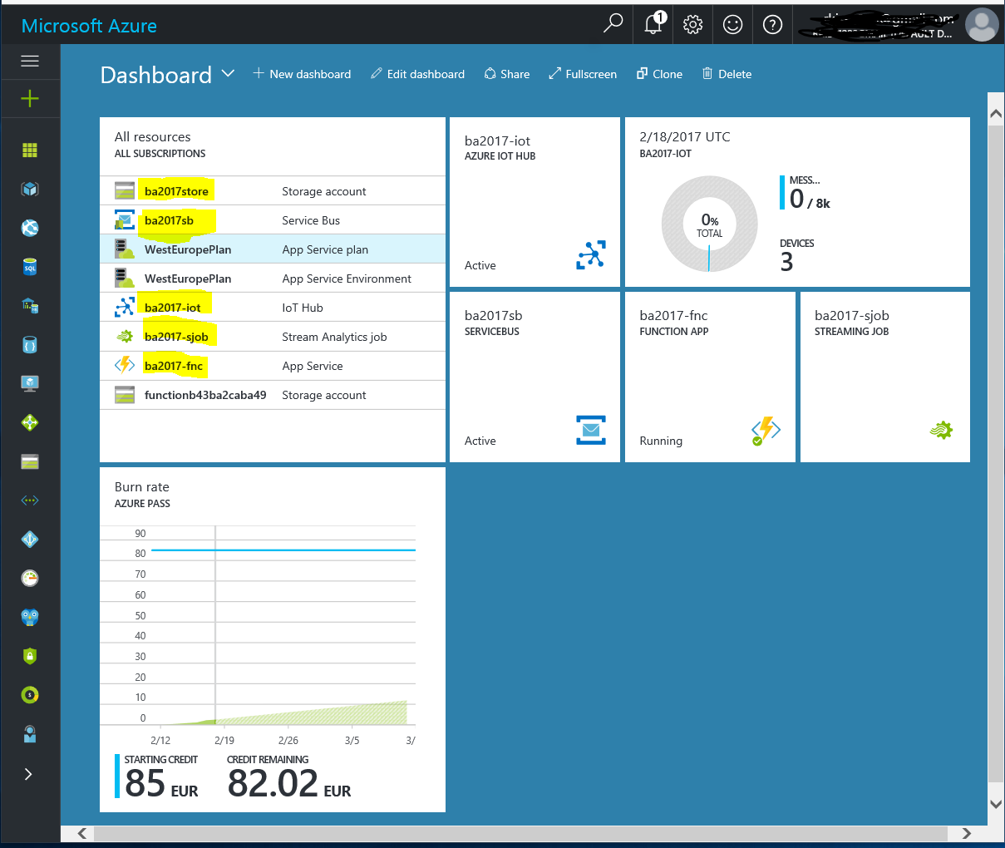
Microsoft Azure Portal
Customize your Dashboard

Slide 16
Install the following 3rd party tools and utilities
Azure Explorer
Azure Storage Explorer
Service Bus Tester
Device Explorer Twin
Azure IoT Hub Tester
Note:
Use the above tools and utilities for exploring your created Azure accounts

Slide 17
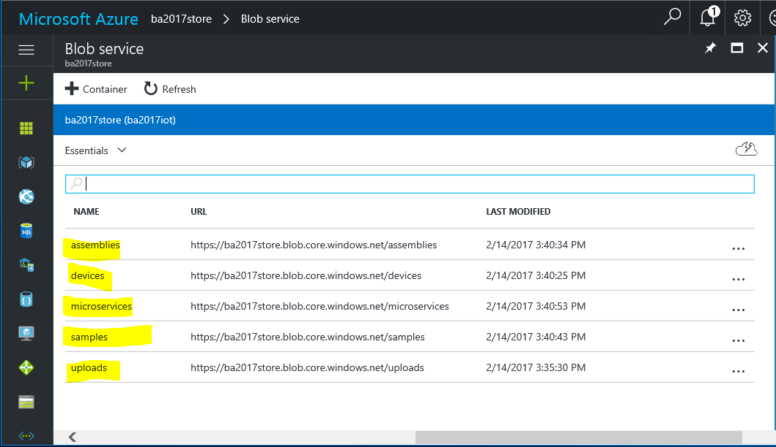

Slide 18
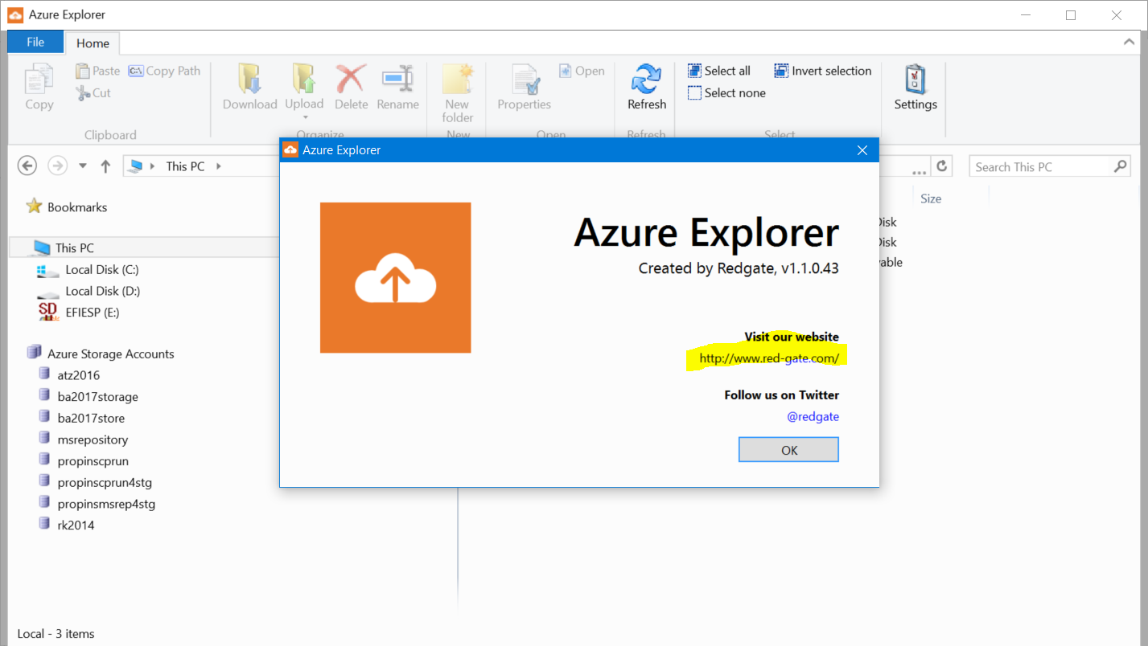

Slide 19
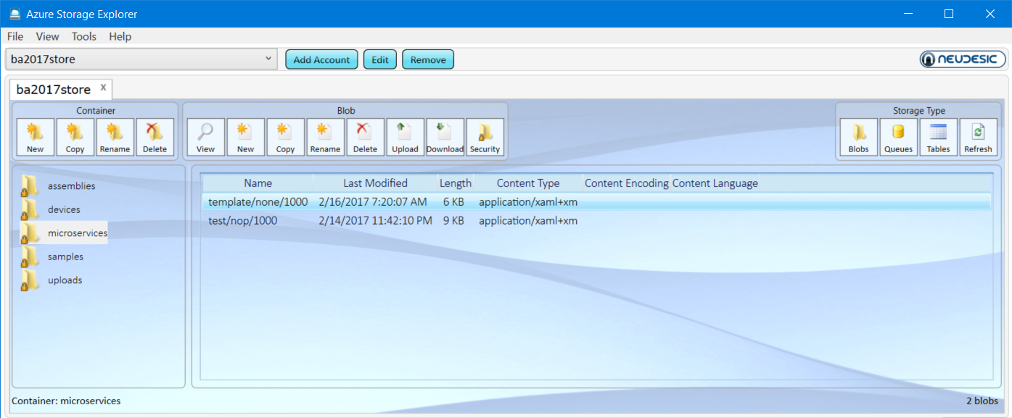
Azure Storage Explorer

Slide 20
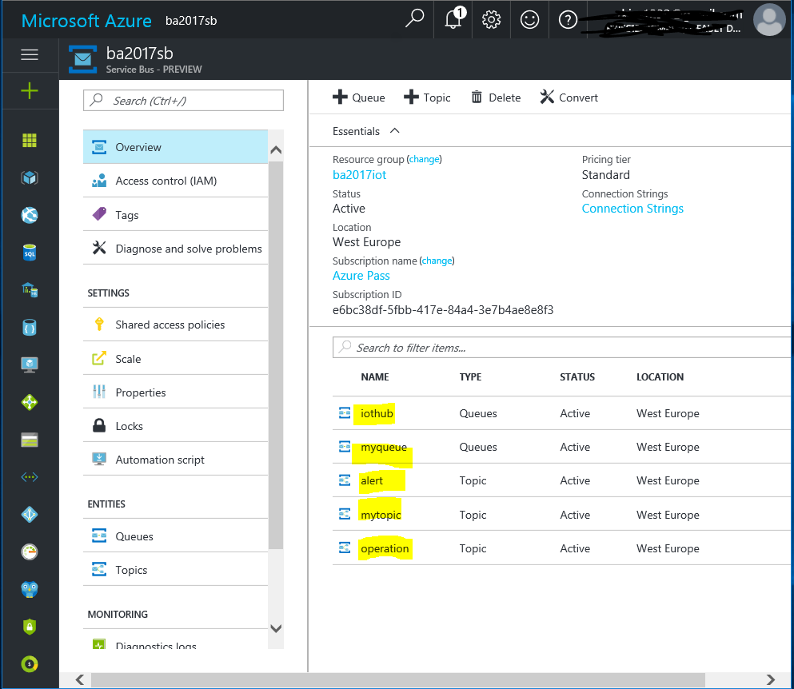
Service Bus
Overview

Slide 21
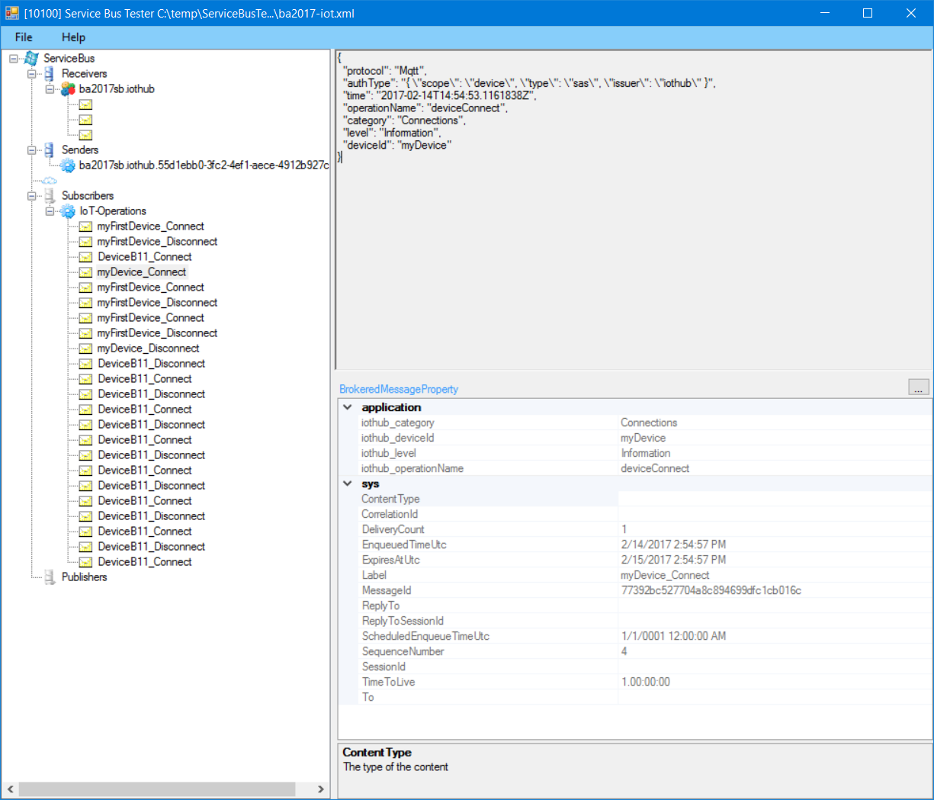
Service Bus Tester

Slide 22
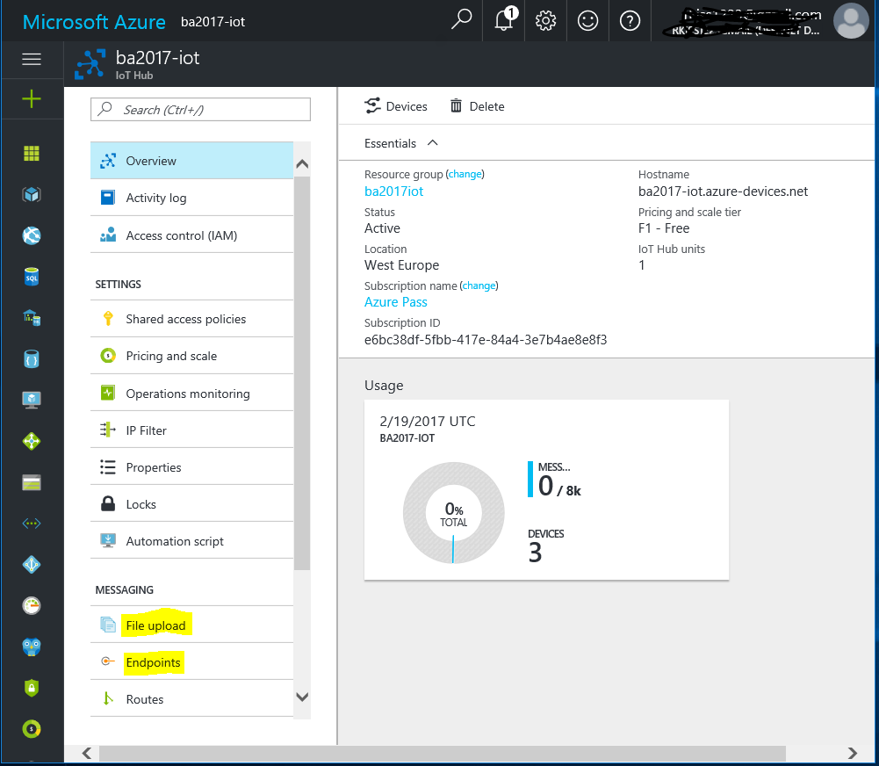
Azure IoT Hub
Overview

Slide 23
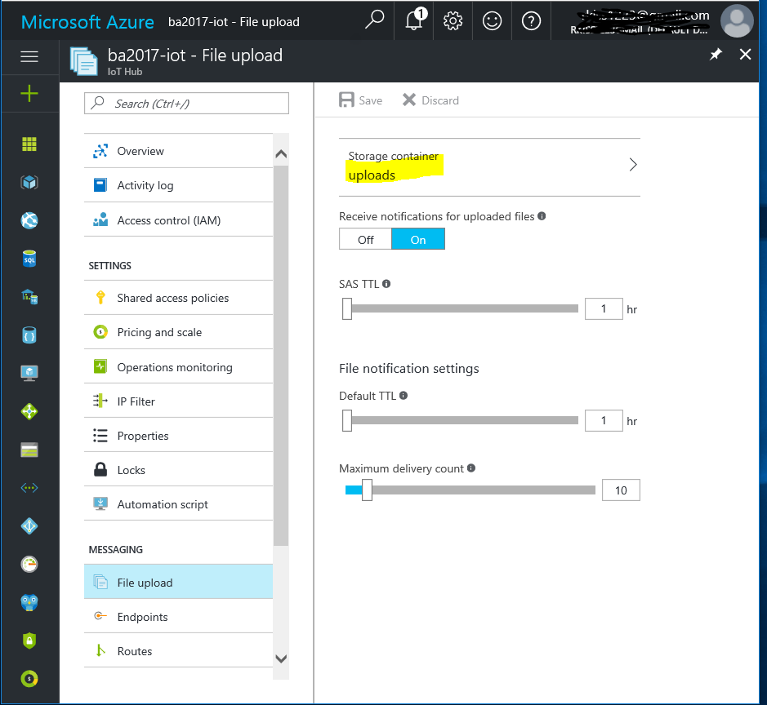
Azure IoT Hub
File Upload

Slide 24
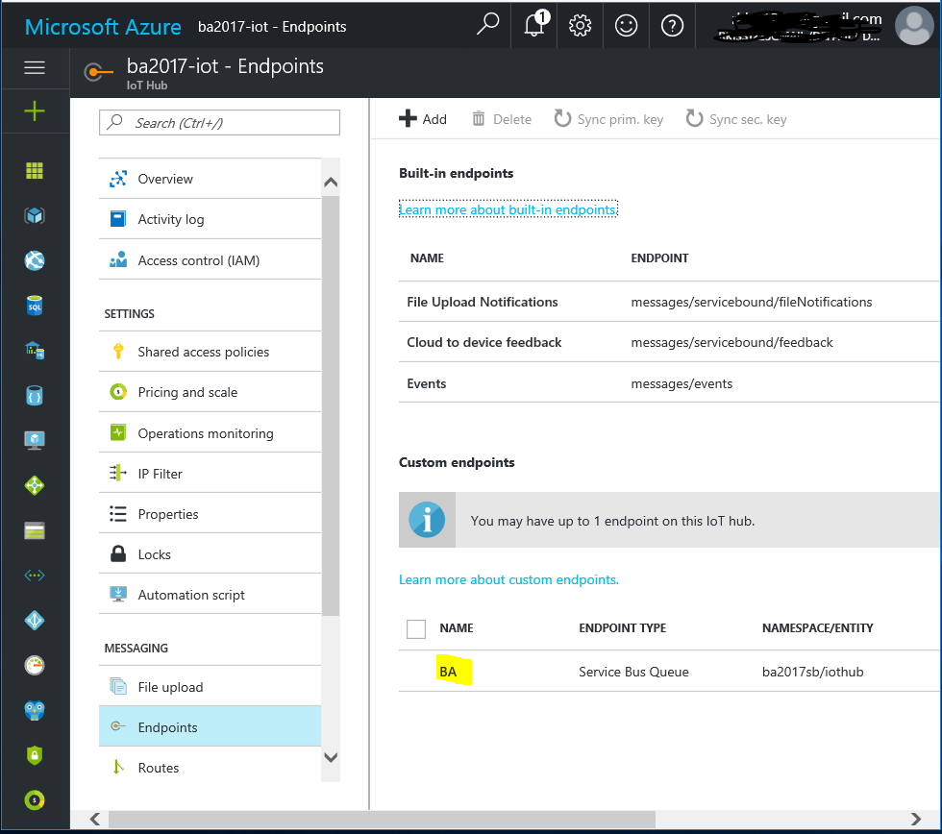
Azure IoT Hub
Endpoints

Slide 25
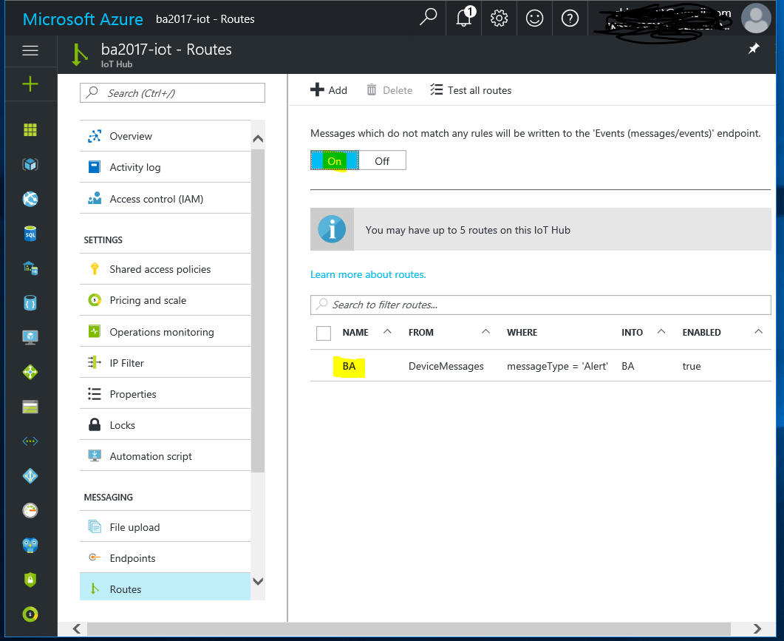
Azure IoT Hub
Routes

Slide 26
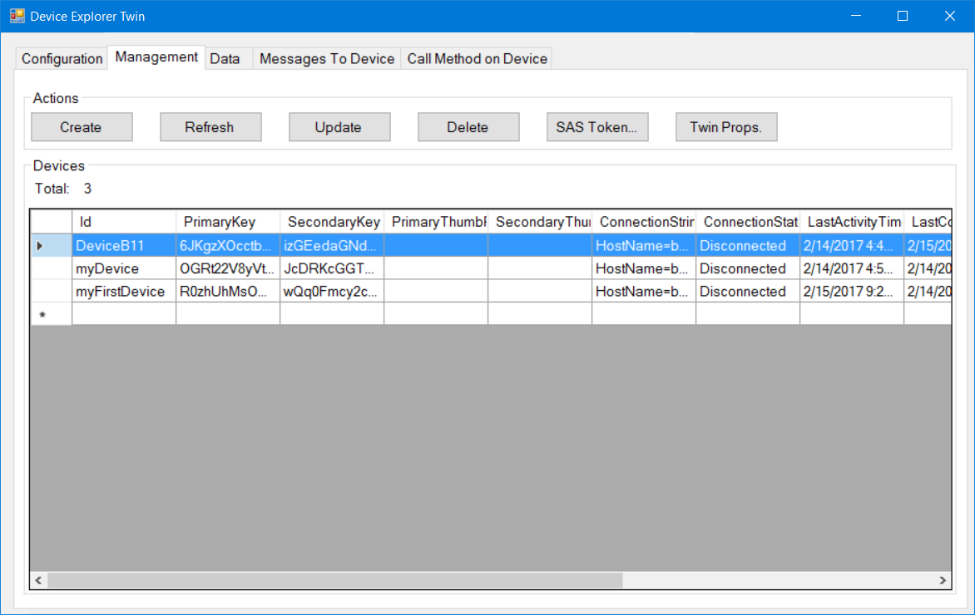
Device Explorer Twin

Slide 27
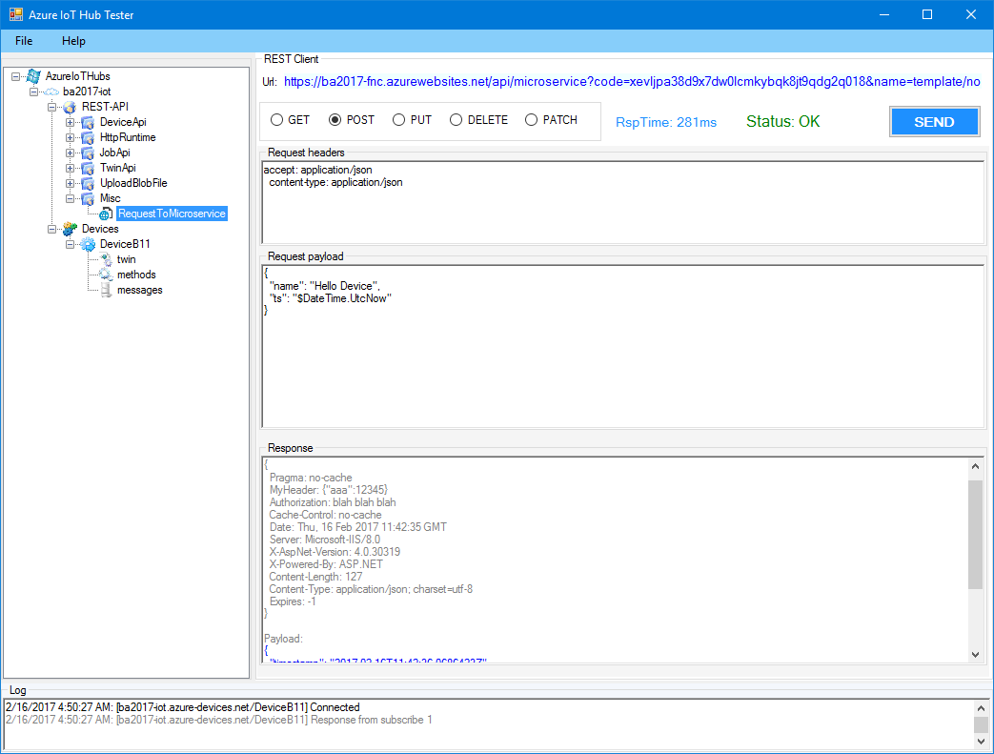
Azure IoT Hub Tester

Slide 28
Exploring Azure IoT Hub
Device and/or Service facing sides
Azure IoT Hub Tester
(MQTT Virtual Device)
Device Explorer Twin (Service-facing side)
Azure IoT Hub Tester
(MQTT Virtual Device)
Azure IoT Hub
Azure IoT Hub

Slide 29
Windows IoT Core
Raspberry Pi3
UWP Apps

Slide 30
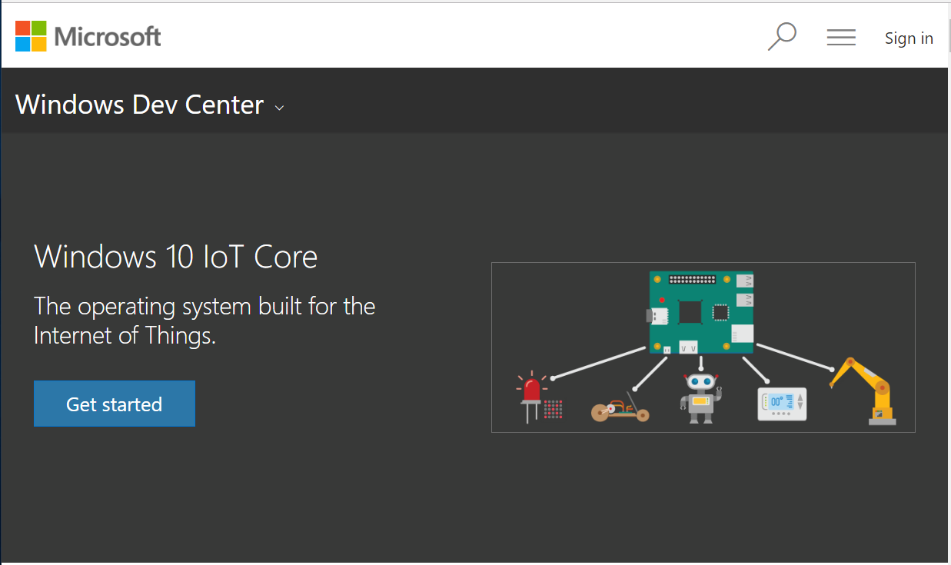
Windows IoT Core
https://developer.microsoft.com/en-us/windows/iot

Slide 31
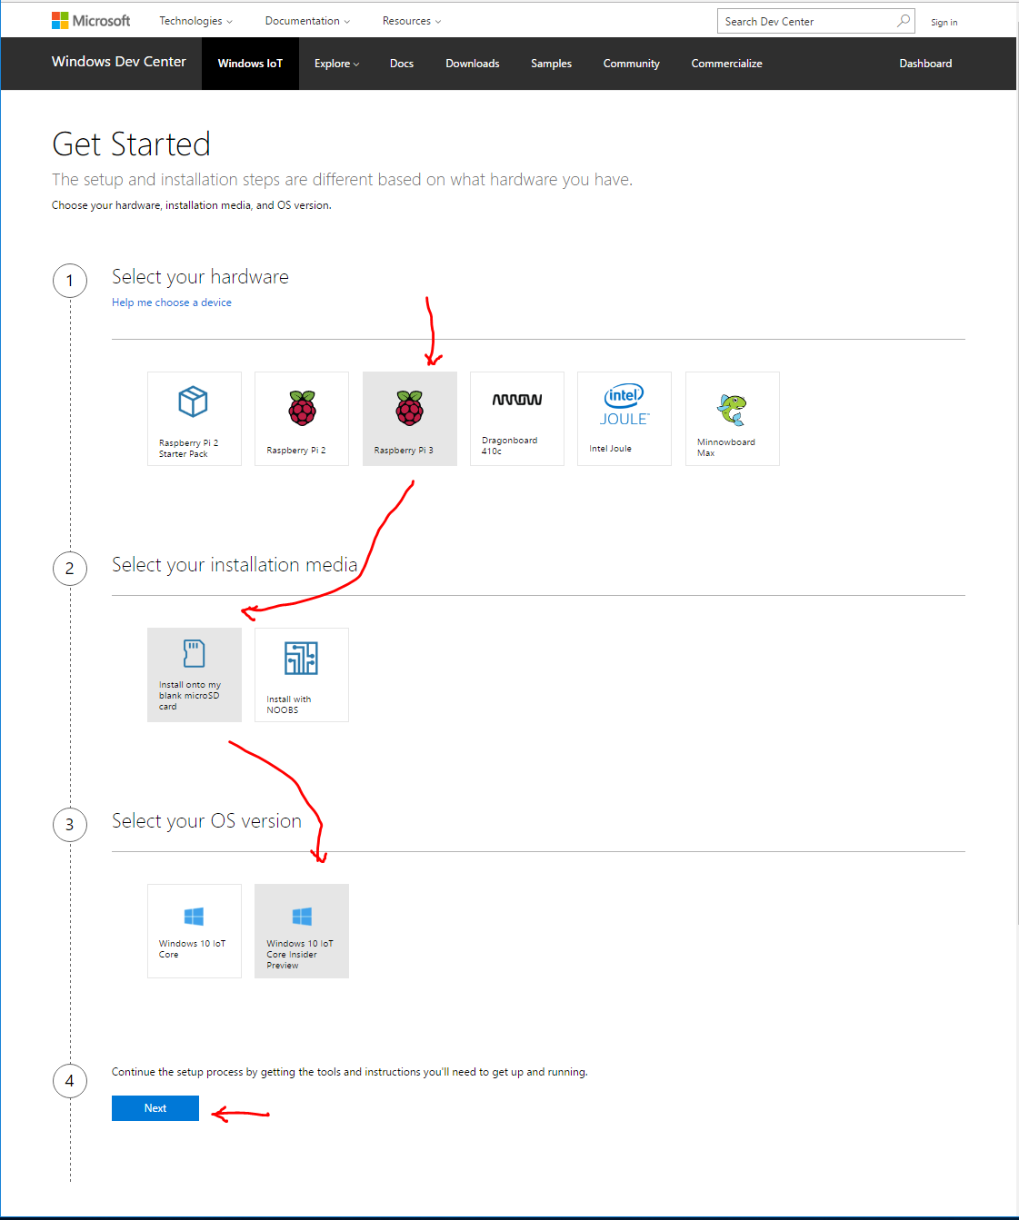
Get Started

Slide 32
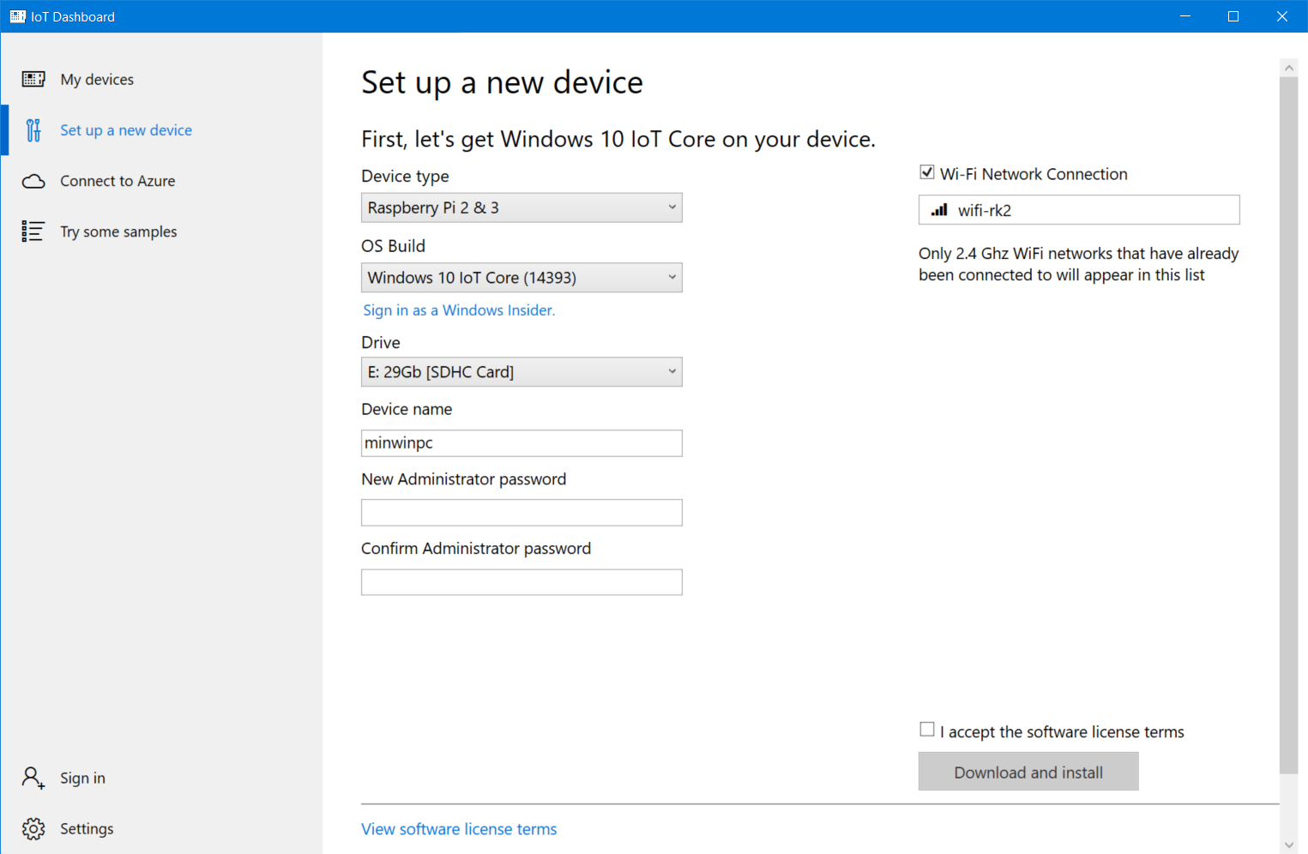
IoT Dashboard

Slide 33
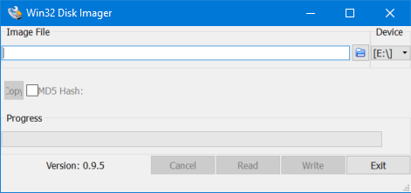
Disk Imager
- Backup microSD
- Create microSD

Slide 34
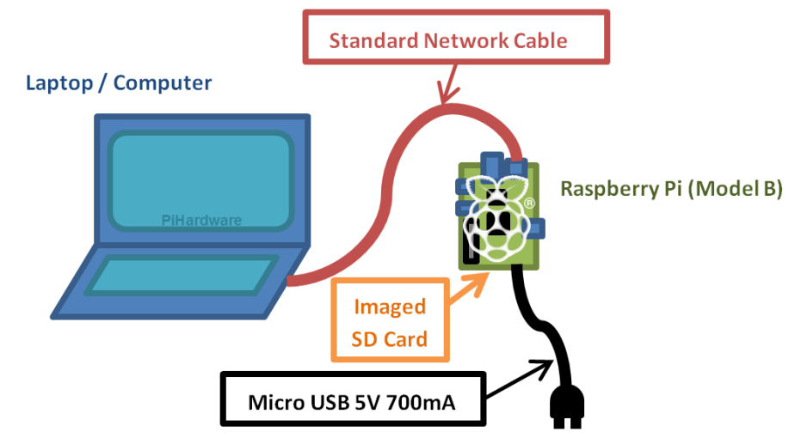

Slide 35
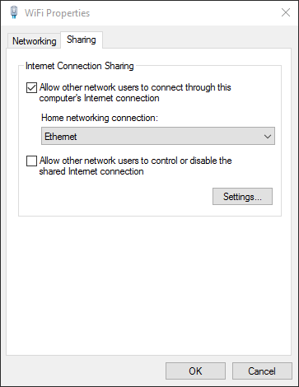
Enable Internet Connection Sharing (ICS):
Guide To…Direct Network Connection:
https://pihw.wordpress.com/guides/direct-network-connection/

Slide 36
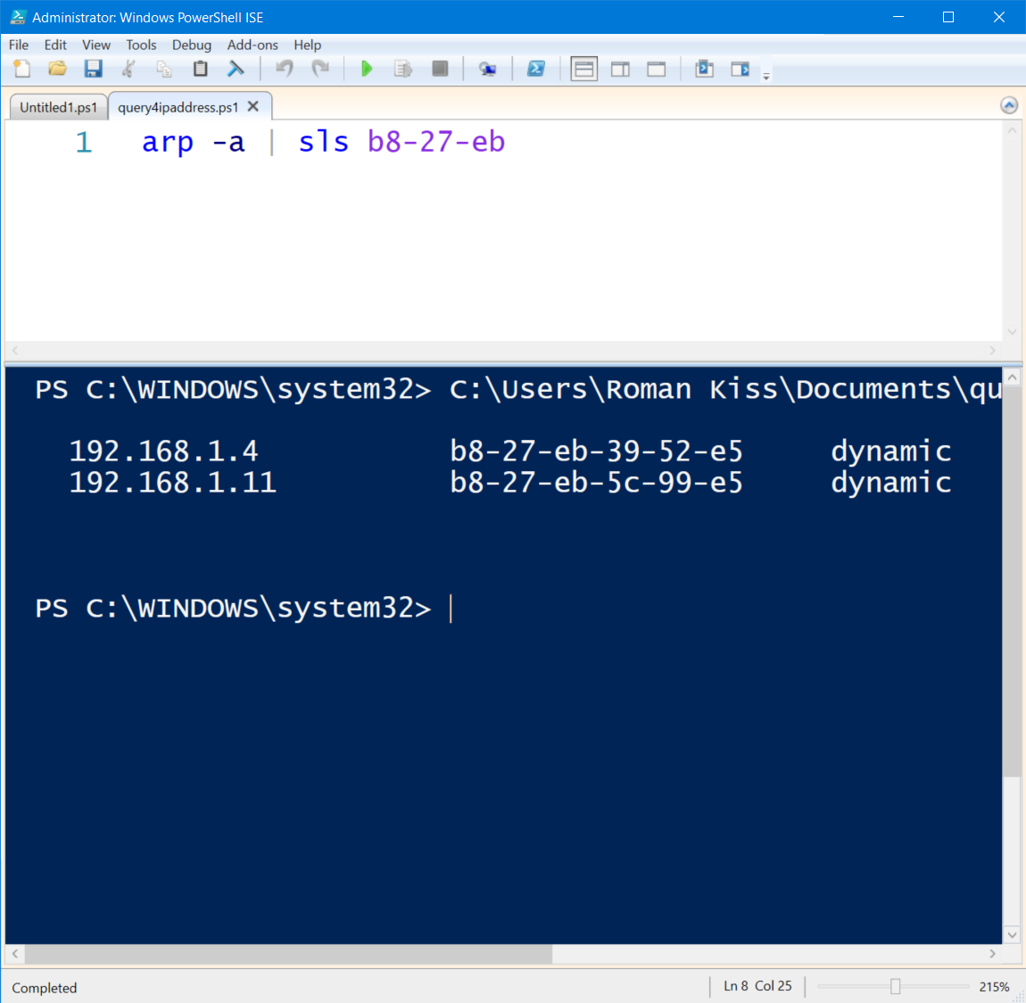
Find ip address for your RPi3

Slide 37
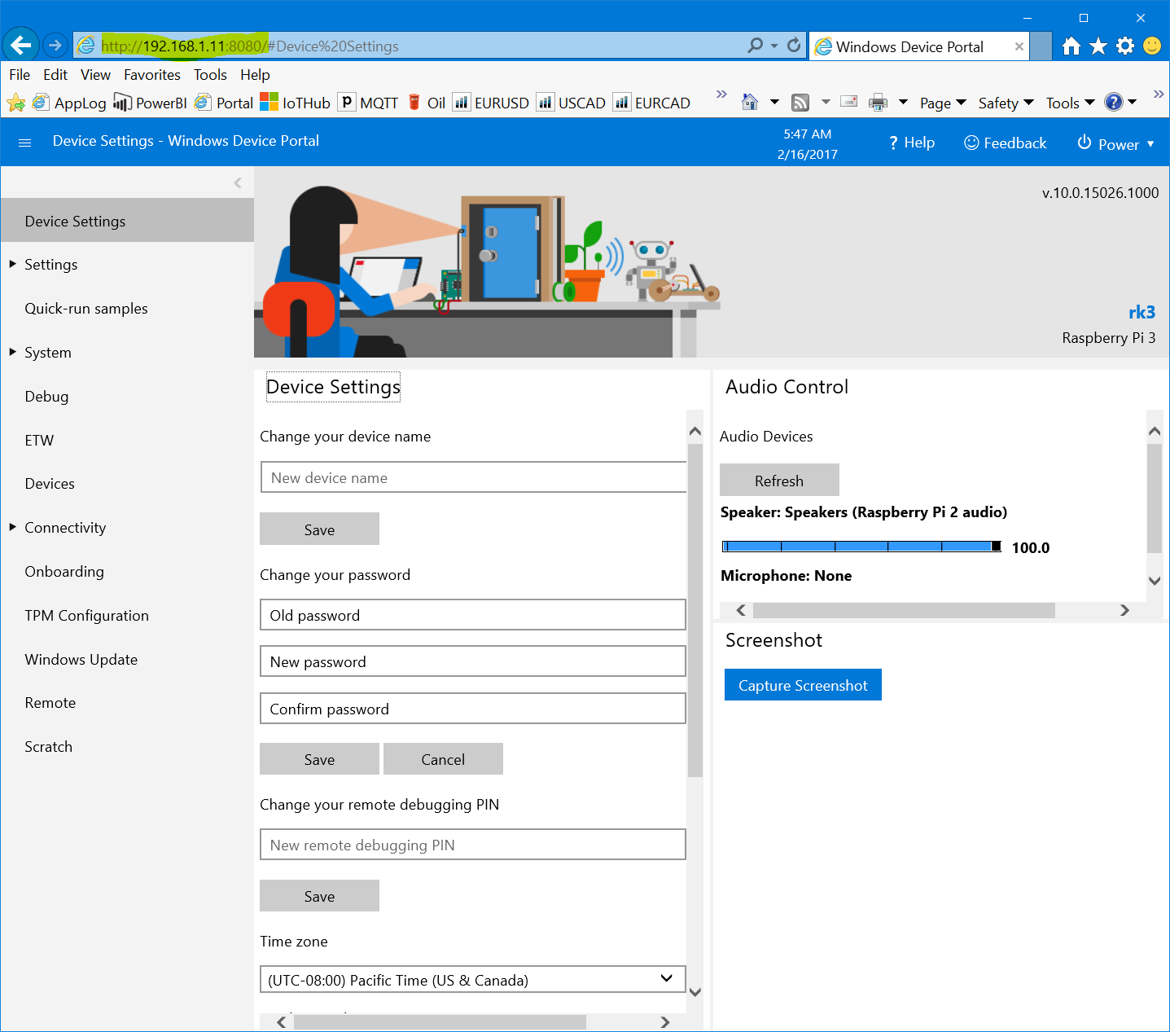
Device Portal
http://192.168.1.11:8080/

Slide 38
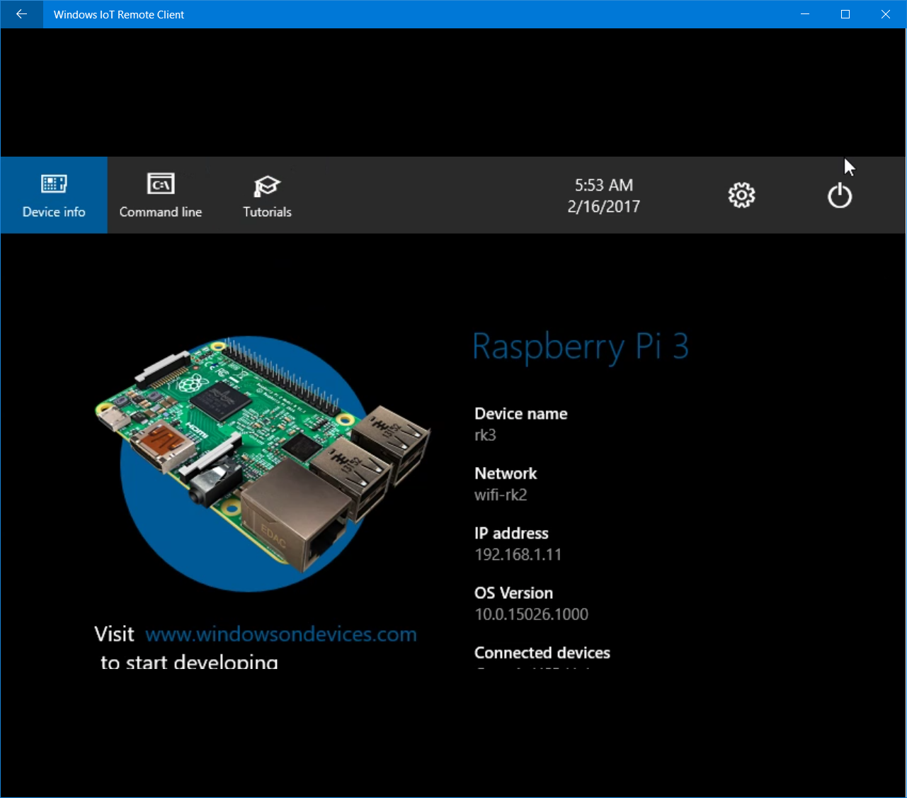
Windows IoT Remote Client

Slide 39
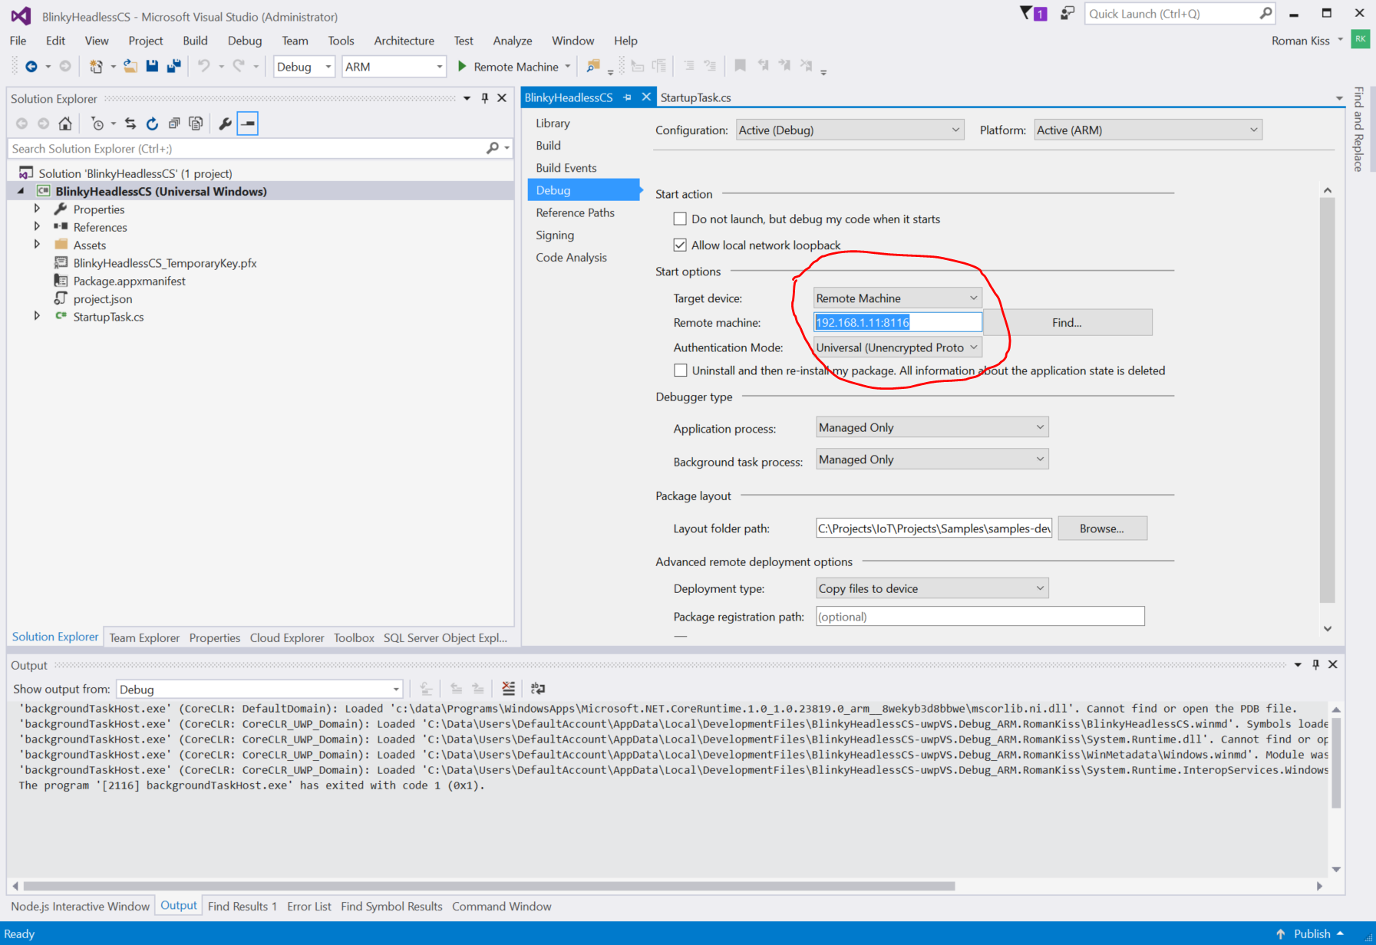
Visual Studio 2015
UWP App
192.168.1.11:8116

Slide 40
Session 1 – Azure IoT Combo
Exploring Azure IoT Hub
Azure IoT Infrastructure
Telemetry path
Non-Telemetry path
Telemetry Router
UploadBlobFile
Exploring Azure IoT Hub
Device-Facing side
Virtual MQTT Device (Azure IoT Hub Tester)
Simulated Device (Client C# SDK )
Service-Facing side
Device Explorer Twin
Simulated App (Service C# SDK)
Device Connectivity (MQTT, HTTPS, AMQP)
Device Twin (States, DirectMethod, Jobs, …)
Plumbing Components (Azure Functions, WorkflowCannels, etc.)
PowerBI (Dashboards)

Slide 41
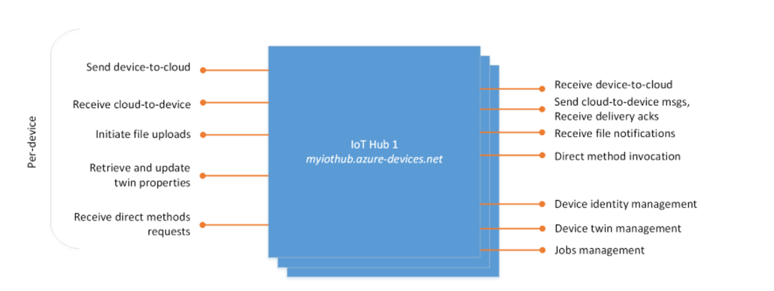
Azure IoT Hub Endpoints
Device-Face Endpoints
Service-Face Endpoints
Telemetry
Telemetry

Slide 42
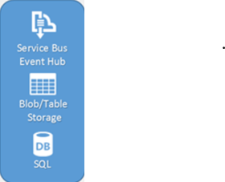



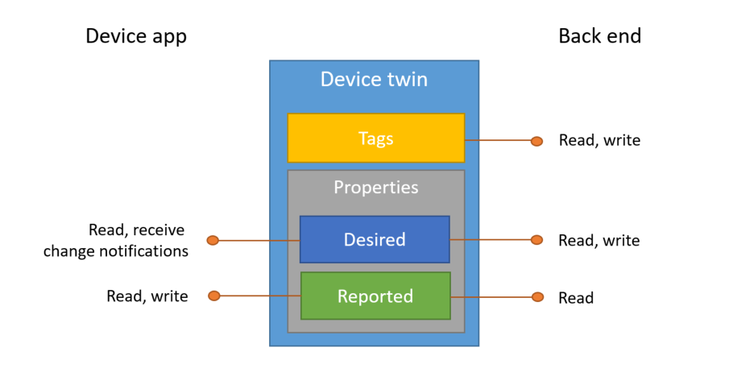
Device/GW/Thing
Telemetry Path
Services
(MQTT, AMQP, Https)
Azure Stream Analytics
(AMQP, REST)
Telemetry Data
Stream Data
Device (Thing) Data
Non-Telemetry Path
Queueing
C2D
C2D
Device Twin (State) Data
Direct Actuary
onDeviceMethod
DirectMethods
InvokeMethod
Jobs
Azure IoT Hub

Slide 43
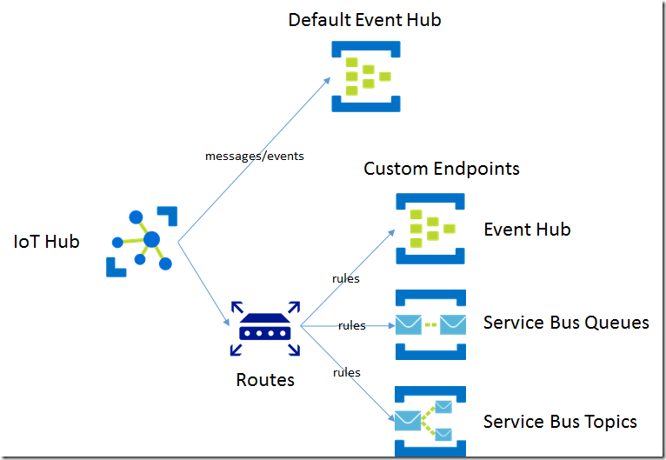
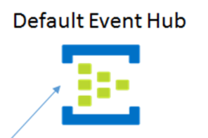
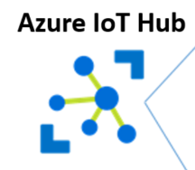
Azure IoT Hub Telemetry Router
Routing is based on the message properties
Azure IoT Hub
no match
or
not properties
…/messages/events/loc=BA&uid=1234
loc=BA and uid=1234
Telemetry Data

Slide 44





Azure IoT Hub Source of Inputs
Routing for stream events (ESP/CEP) and message processing
Default Event Hub
Stream Analytics
Custom Endpoints
Stream Analytics
Event Hub
IoT Hub
/messages/events
R
Service Bus Queue
Azure Functions
Service Bus Topic
Azure Functions
S1: 10 endpoints
100 rules

Slide 45
Azure Stream Analytics
Telemetry path

Slide 46
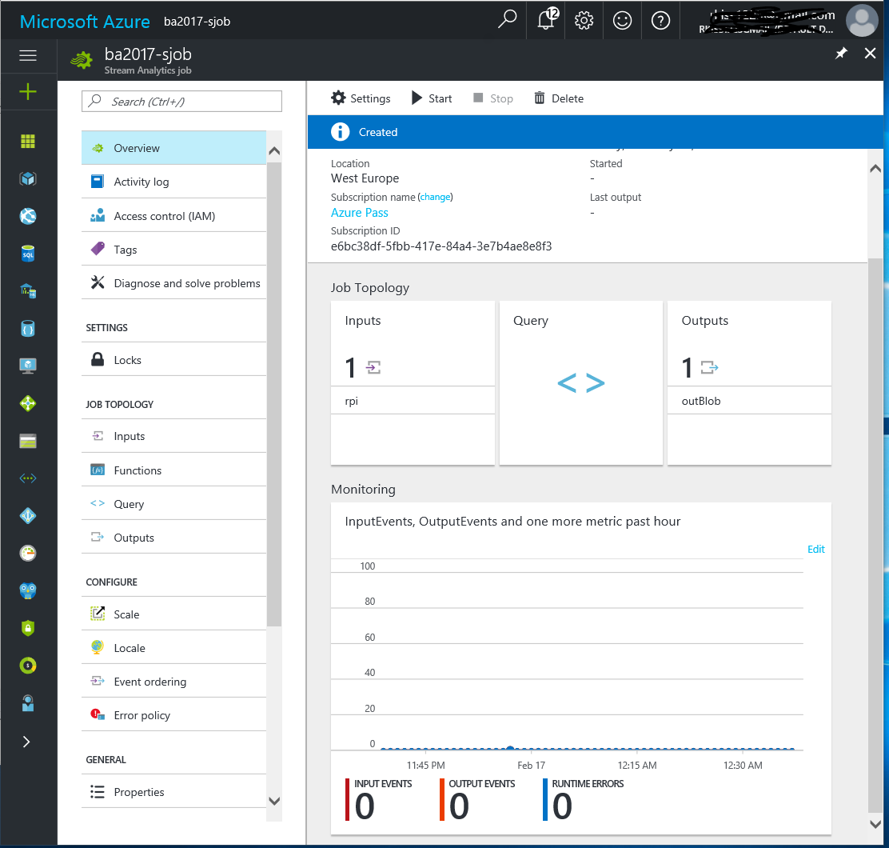
Stream Analytics Job
Min Job:
Cold path – stream data into Blob
SELECT
System.TIMESTAMP AS TIME, *
INTO
outBlob
FROM
rpi TIMESTAMP BY TIME

Slide 47
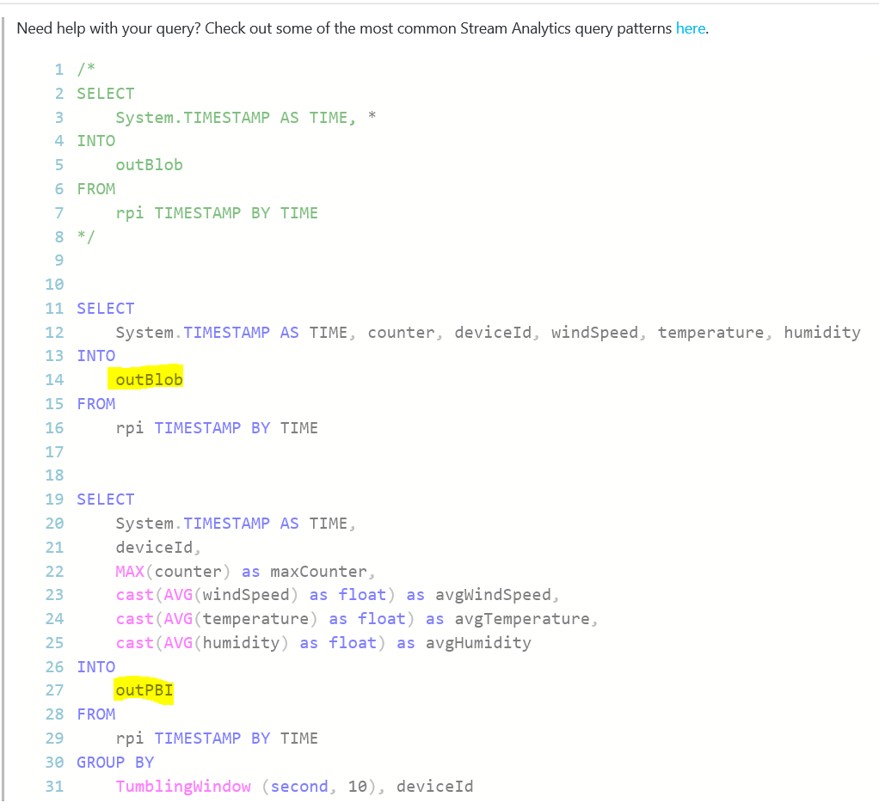

Slide 48
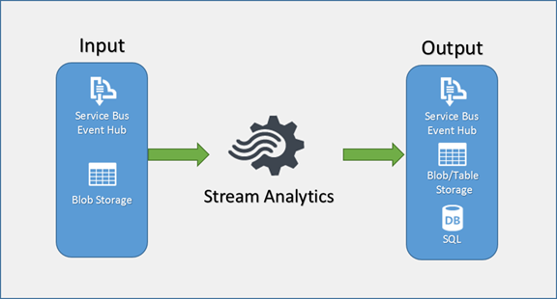
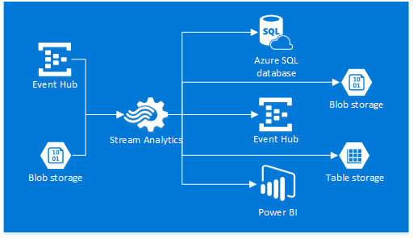
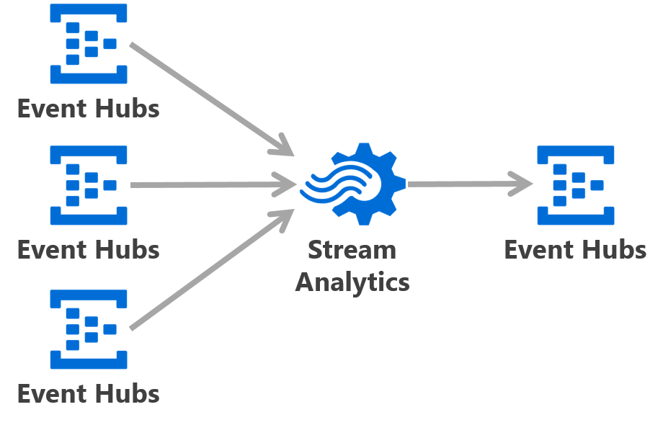

Slide 49

Azure Stream Analytics and Event Hubs
Routing for stream events (ESP/CEP) and message processing
Event Hubs
Event Hubs
Event Hub
Stream Analytics
Stream Analytics
Event Hub

Slide 50
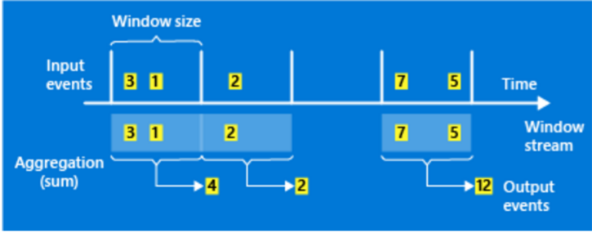

Windowing

Slide 51
Azure Functions
Non-Telemetry Path

Slide 52
Device/GW/Thing
Services
(MQTT, AMQP, Https)
Azure Stream Analytics
Queue/Topic
(AMQP, REST)
Telemetry Data
Stream Data
Device (Thing) Data
Azure
Functions
C2D
C2D
async
Queueing
Device Twin (State) Data
onDeviceMethod
DirectMethods
InvokeMethod
sync
Direct Actuary
Azure IoT Hub

Slide 53



Azure IoT Hub Telemetry and Non-Telemetry Paths
Device-To-Cloud, Cloud-to-Device, Device-To-Device
Telemetry Path
Stream Analytics
IoT Hub
DefaultEndpoint
No-Rules
No-Match
Non-Telemetry Path
Custom Service Bus Queue
/devices/{deviceId}/messages/events/{propBag}
CustomEndpoint
Azure Function
Rule ABC
MQTT, AMQP, HTTP
Device (Thing)
/messages/devicebound
/devices/{deviceId}/messages/devicebound
/messages/servicebound/feedback

Slide 54

Updating Device twin reported/ properties
Telemetry Path
Stream Analytics
2
/devices/{deviceId}/messages/events/{propBag}
IoT Hub
DefaultEndpoint
No-Rules
No-Match
Non-Telemetry Path
Custom Service Bus Queue
CustomEndpoint
3
Azure Function
Device (Thing)
Rule ABC
MQTT
6
Read, receive change notifications
Read/Write properties
5
1
Read/Write properties
Read properties
4
/messages/devicebound
/devices/{deviceId}/messages/devicebound
/messages/servicebound/feedback
C2D Messaging

Slide 55
Power BI
Visualizing Telemetry Data

Slide 56

PowerBI Designer

Slide 57

Live Dashboard

Slide 58



Example of the Device-To-Device Communications
Telemetry Path
Stream Analytics
1
/devices/Device1/messages/events
IoT Hub
DefaultEndpoint
https
4
/devices/Device1/messages/devicebound
No-Rules
No-Match
Non-Telemetry Path
Device1
Custom Service Bus Queue
CustomEndpoint
Azure Function
Rule ABC
MQTT, AMQP, HTTP
Device2
/messages/devicebound
2
/devices/Device2/messages/deviceBound
3
/devices/Device2/messages/events/{propBag}
/messages/servicebound/feedback
Raspberry Pi3 + Windows IoT Core

Slide 59
Session 2 – IoT Devices
Device Definition
Device Twin, Methods, Telemetry Data, …
Type of Devices
Simulated and Virtual Devices
Real Device – Raspberry Pi3
Device Connectivity
MQTT, AMQP, HTTPs
Windows IoT Core
Device Portal
Visual Studio 2015
UWP, Windows IoT Core Project Templates, …
Headed (Foreground) vs Headless (Background) Apps
Creating Empty Device Image
Deployment, Debugging, …

Slide 60




MQTT Quality of Service
Azure IoT Hub
Azure IoT Hub
(fire & forget)
Azure IoT Hub

Slide 61

MQTT Quality of Service

Slide 62


Slide 63


Slide 64
Session 3 – End-To-End
Device
Sensoring, Buttons, Relay/LED, etc.
Azure IoT Combo
Routing
Stream Job
Operation Monitoring
Azure Functions (bridges, triggers, VETERs, etc.)
Azure Power BI
Datasets, REST Endpoint, Reports, Dashboards

Slide 65
Exploring End-To-End IoT Data
From VS2015-To-PowerBI via IoT Combo

Slide 66



Pushing a Sensor Telemetry to the Azure IoT Hub
Device-To-Cloud and Cloud-To-Device Messaging
Field Gateway + Sensors
Raspberry Pi3 + Windows IoT Core
Real-Time Data Stream
Back-End Application
Action + Feedback

Slide 67







Example: Pushing an application telemetry to the IoT Hub
App
PowerBI – Live Dashboard
IoT Hub
Runtime Dataset

Slide 68

Telemetry Pre-Processing

Slide 69



Slide 70
Congratulations!
Now you are ready to start a Real Project.

Slide 71
Appendix
A

Slide 72



Azure Function - VETER Message Mediator
https://xxxxxx.azurewebsites.net/api/microservice?code=xxxxx&name=HelloCloud
Microservice VETER
Designer Tool

Slide 73

Telemetry Data Stream with VETER Mediator
Event Hub Triger Bridge to WCF Client
HTTP Triger Bridge to WCF Client
? Triger Bridge to WCF Client
WCF Workflow Channel
Dynamic Activity
(xaml definition)
Blob Storage

Slide 74


Slide 75

Azure IoT Hub Telemetry and Non-Telemetry Paths
Device-To-Cloud, Cloud-to-Device, Device-To-Device
Telemetry Path
Stream Analytics
/devices/{deviceId}/messages/events/{propBag}
IoT Hub
DefaultEndpoint
No-Rules
No-Match
Non-Telemetry Path
Custom Service Bus Queue
CustomEndpoint
Worker
Role
Device (Thing)
MQTT, AMQP, HTTP
Rule ABC
Azure Storage Table
(states)
/messages/devicebound
/devices/{deviceId}/messages/devicebound
/messages/servicebound/feedback
VETER Pattern

Slide 76
Azure IoT Hub
MQTT
REST
onDeviceMethod
DirectMethods
InvokeMethod
Jobs

Slide 77
Azure IoT Virtual Device
IoT Device
Azure IoT Hub
Real Device
IoT Edge
Virtual Device
MQTT
REST
Device Twin
Properties
Desired
Read, Change Notification
Reported
Read, Write
Request/Response
DirectMethods
DirectMethods
InvokeMethod
Jobs

Slide 78
Updating Device twin reported/ properties
Telemetry Path
Stream Analytics
2
/devices/{deviceId}/messages/events/{propBag}
IoT Hub
DefaultEndpoint
No-Rules
No-Match
Non-Telemetry Path
Custom Service Bus Queue
CustomEndpoint
3
Azure Function
Device (Thing)
Rule ABC
MQTT
6
Read, receive change notifications
Read/Write properties
5
1
Read/Write properties
Read properties
4
/messages/devicebound
/devices/{deviceId}/messages/devicebound
/messages/servicebound/feedback
C2D Messaging

Slide 79
Example of the Device-To-Device Communications
Telemetry Path
Stream Analytics
IoT Hub
DefaultEndpoint
No-Rules
No-Match
MQTT, AMQP, HTTP
Device2
Non-Telemetry Path
Custom Service Bus Queue
1
/devices/Device2/messages/events/{propBag}
D2C
2
CustomEndpoint
3
Azure Function
Rule ABC
6
/devices/Device2/messages/deviceBound
C2D
/messages/devicebound
5
Raspberry Pi3 + Windows IoT Core
7
4
/messages/servicebound/feedback
SQL

Slide 80

Ingestion
Validation
Enrichment
Transformation
Aggregation
Routes
Things
IoT Hub
ASA Job
Event Hub
ASA Job
Downstream
Consumers
PowerBI,
Service Bus,
Storage,
etc.
stream
Non-telemetry
ref
archive
stream
…
Service Bus Queue
Blob Storage
Event Hub
Azure Function
/messages/devicebound

Slide 81
Ingestion
Validation
Enrichment
Transformation
Routes
Things
IoT Hub
AFN
Event Hub
AFN
Downstream
Consumers
PowerBI,
Service Bus,
Storage,
etc.
stream
Non-telemetry
ref
archive
Service Bus Queue
Blob Storage
/messages/devicebound
Https
Azure Function

Slide 82
Validation
Enrichment
Transformation
Route
Ingestion
Things
IoT Hub
AFN
Downstream
Consumers
PowerBI,
Service Bus,
Storage,
etc.
stream
Non-telemetry
ref
archive
Service Bus Queue
Blob Storage
Azure Function
/messages/devicebound

Slide 83
Ingestion
Validation
Enrichment
Transformation
Routes
Things
IoT Hub
Worker Role
Event Hub
Worker Role
Downstream
Consumers
PowerBI,
Service Bus,
Storage,
etc.
stream
Non-telemetry
ref
archive
Service Bus Queue
Blob Storage
/messages/devicebound
Https
Azure Function

Slide 84
Ingestion
Validation
Enrichment
Transformation
Routes
Things
IoT Hub
AFN
Event Hub
AFN
Downstream
Consumers
PowerBI,
Service Bus,
Storage,
etc.
stream
Non-telemetry
ref
archive
Service Bus Queue
Blob Storage
/messages/devicebound
Https
Azure Function

Slide 85
Azure IoT Hub Source of Inputs
Routing for stream events (ESP/CEP) and message processing
Telemetry Path (stream pipeline)
Default Event Hub
Azure Functions
Service Bus Queue
/messages/events
R
Service Bus Queue
Non-Telemetry Path
Custom Endpoints
…
IoT Hub

Slide 86
Azure IoT Hub Source of Inputs
Routing for stream events (ESP/CEP) and message processing
Telemetry Path (stream pipeline)
Default Event Hub
EventProcessorHost
Worker Role
IoT Hub
Non-Telemetry Path
Custom Endpoints
/messages/events
R
Service Bus Queue
Azure Functions
Service Bus Topic
Azure Functions
S1: 10 endpoints
100 rules

Slide 87
Azure Function - VETER Message Mediator
https://xxxxxx.azurewebsites.net/api/microservice?code=xxxxx&name=HelloCloud
Http Trigger
Http Response

Slide 88
Microsoft Internet of Things
High Level Topology
Azure IoT Edge
Azure
IoT Device
IoT Hub
Customer
Solution
(Stack)
IoT Device
Azure IoT Edge

Slide 89


Slide 90


Slide 91


Slide 92


Slide 93
Azure Function - VETER Message Mediator
https://xxxxxx.azurewebsites.net/api/microservice?code=xxxxx&name=HelloCloud
REST
WCF Workflow
Channel
REST
Req
Rsp

Slide 94
Https
Azure Function
Azure IoT Hub
/messages/devicebound
AMQP
HttpC2D

Slide 95


